Slide 1
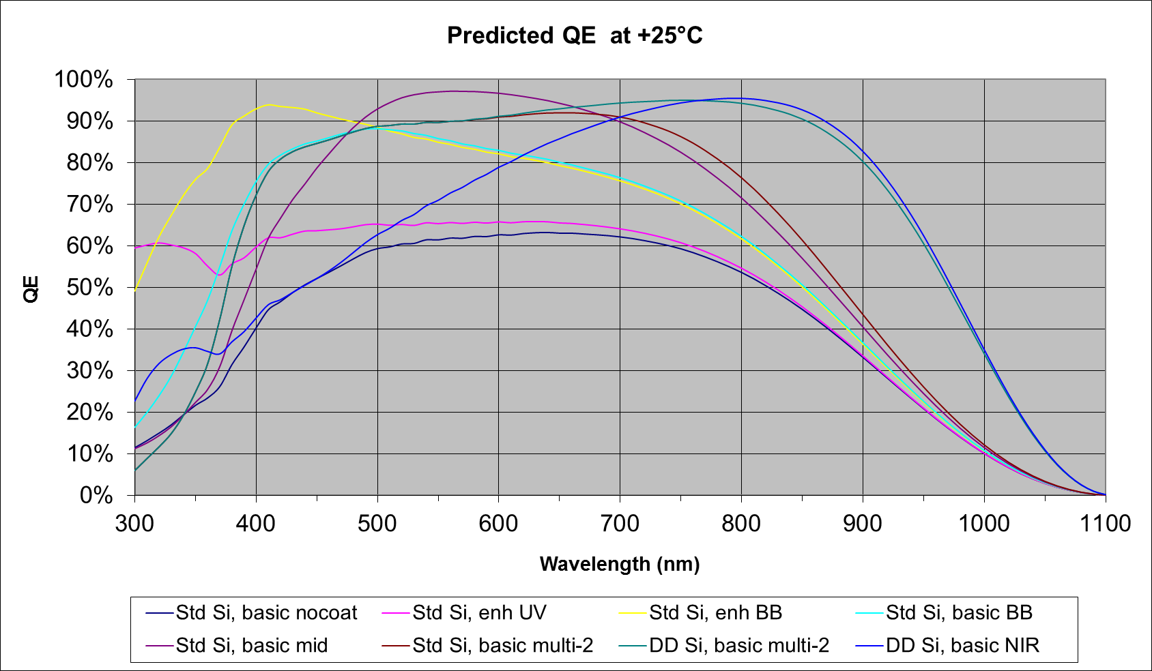
Modeled QE of standard AR coatings at +25C.

Slide 2
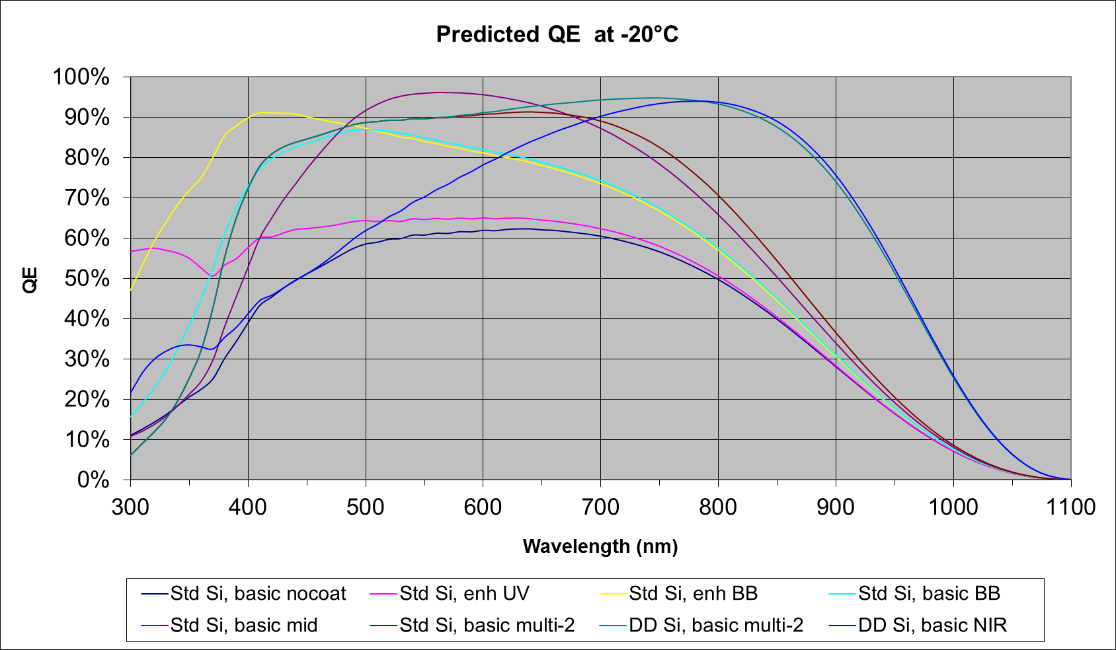
Modeled QE of standard AR coatings at -20C

Slide 3
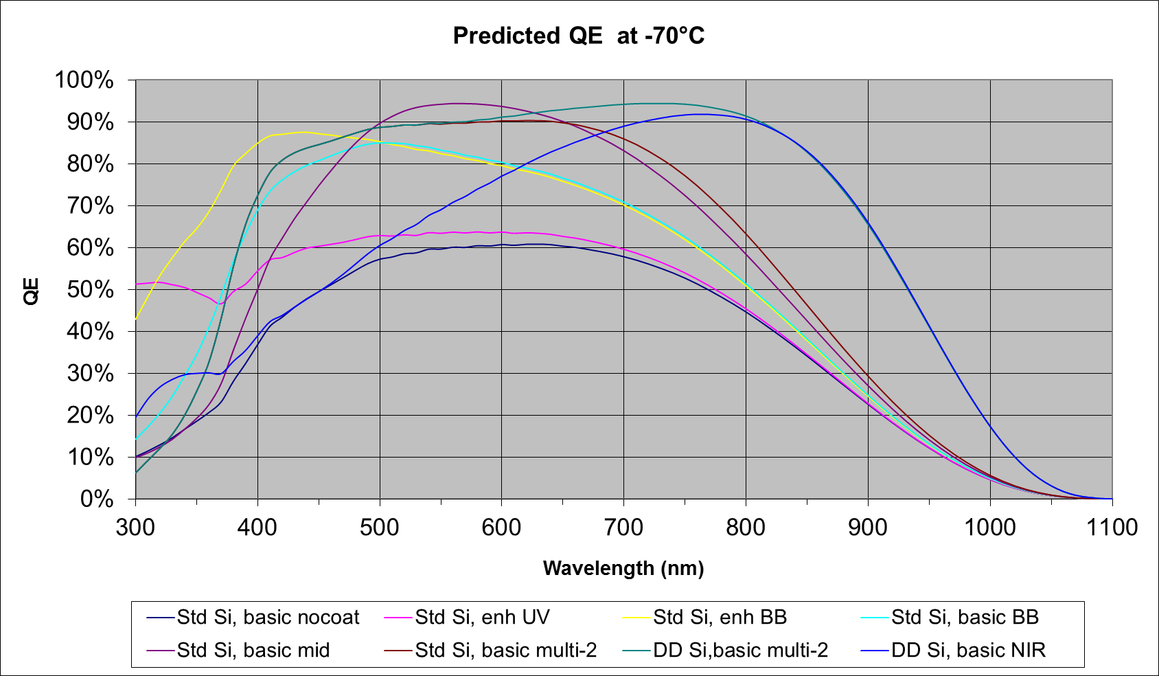
Modeled QE of standard AR coatings at -70C

Slide 4
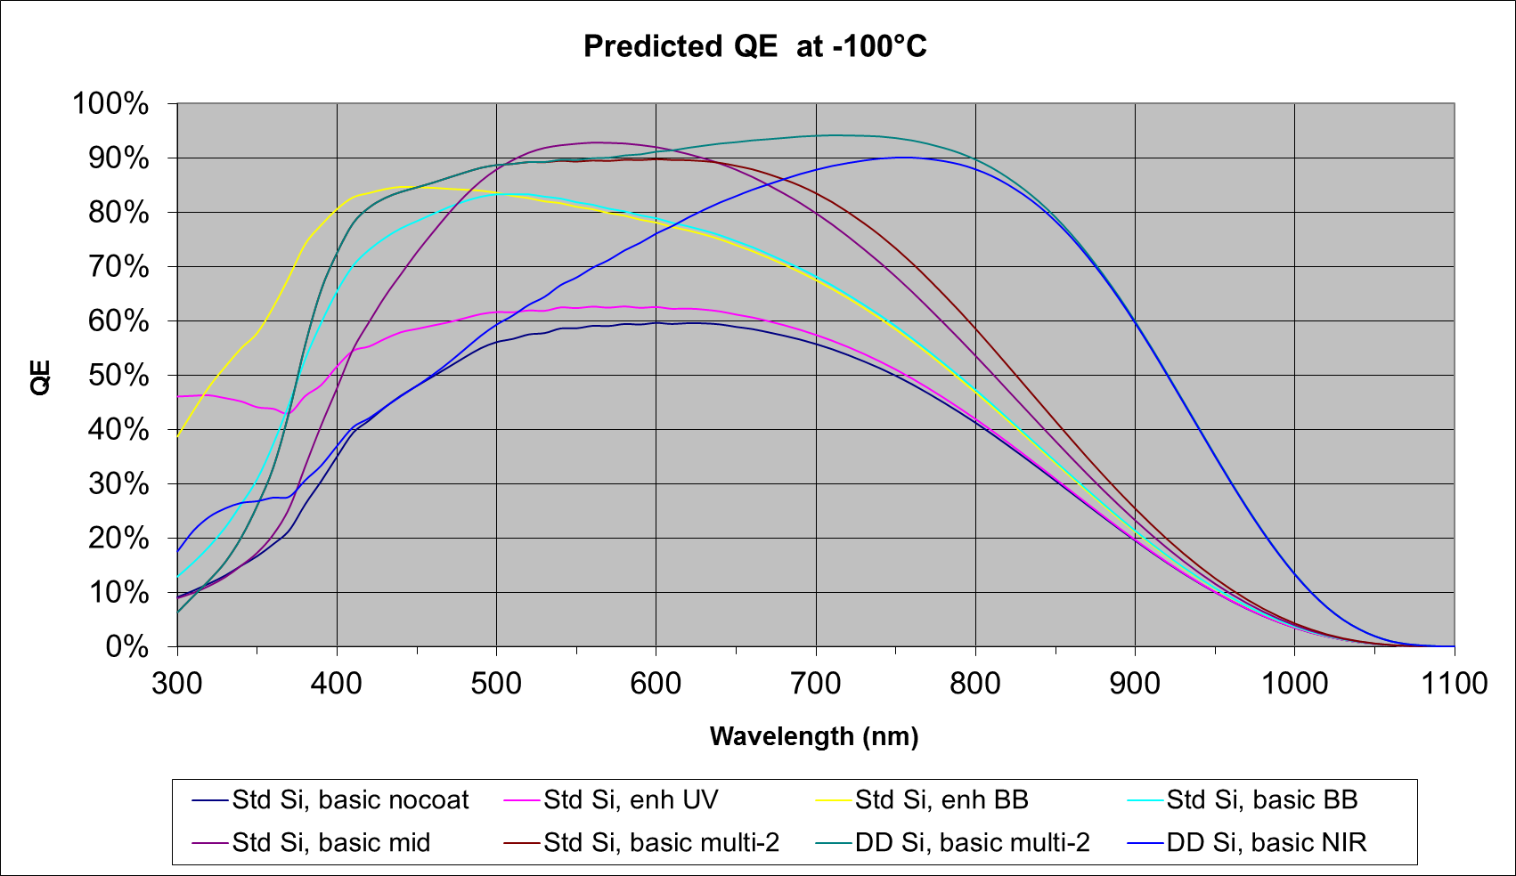
Modeled QE of standard AR coatings at -100C

